Slide 1
TOSCA Modeling for NFV - Introduction
Andrei Kojukhov, PhD
Technology Strategy & Standardization
April 2018

Slide 2



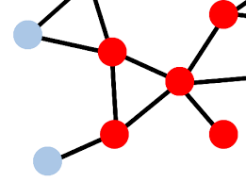
Agenda & Scope of Two Sessions
Introduction to TOSCA - Topology and Orchestration Specification for Cloud Applications
TOSCA Modeling for NFV
ETSI Info Model for VNF Package and VNF Descriptor
TOSCA Data Model for VNF Descriptor
Assumption: There is no standard TOSCA–based VNFD and NSD in industry
The TOSCA Introduction presents a Work In Progress

Slide 3




Orchestration Modeling Convergence
Cloud Applications
Telco NFV
TOSCA / XML
1
1
VNFD & NSD Info Models
NFV-IFA011 & MFV-IFA014
TOSCA / YAML 1.0/1.1/1.2
2
Move
2
TOSCA based VNFD & NSD Data Models
NFV-SOL001
TOSCA / YAML NFV Profile
3
TOSCA / YAML NFV Profile 2.0
4
Communicate deployment Experience (ONAP etc.)

Slide 4
Main References
OASIS
TOSCA Simple Profile in YAML Version 1.1
http://docs.oasis-open.org/tosca/TOSCA-Simple-Profile-YAML/v1.1/cs01/TOSCA-Simple-Profile-YAML-v1.1-cs01.html
The TOSCA Simple Profile for NFV v1.0 (Draft) - obsolete
http://docs.oasis-open.org/tosca/tosca-nfv/v1.0/csd04/tosca-nfv-v1.0-csd04.html
ETSI
Info Model for VNF Package and VNFD – ETSI NFV-IFA011
http://www.etsi.org/deliver/etsi_gs/NFV-IFA/001_099/011/02.03.01_60/gs_nfv-ifa011v020301p.pdf
TOSCA Based Data Model for NFV Descriptors – ETSI NFV-SOL001 (draft)

Slide 5

TOSCA YAML Version 1.1 – Cloud Application Orchestration

Slide 6


What Makes TOSCA Unique?
TOSCA is an Intent Model which is declarative (integration points for imperative)
incorporates both Data and Information Model features and concepts …
Intent Model Adds:
Topology
Composition
Requirements - Capabilities
State (Nodes, Relationships)
Lifecycle (Management)
Policy
TOSCA can work with imperative scripts (e.g., Ansible, Chef, Bash, Ant, etc.)
TOSCA can include other data models (e.g., JSON, YANG)
Structure
Format
interfaces
Types, Relationships
Properties
Operations
Data Models
Typically, describe the structure (format), enabling manipulation (via interfaces) of the data stored in data management systems assuring integrity.
Information Models
Typically, used to model a constrained domain that can be described by a closed set of entity types, properties, relationships and operations.
… but brings unique orchestration concepts focus in Lifecycle mgmt. and State

Slide 7
Topology – Define Topology with Nodes and Relationships
TOSCA is used first and foremost to describe the topology of the deployment view for cloud applications and services
Node templates to describe components in the topology structure
Relationship templates to describe connections, dependencies, deployment ordering
Nodes - are the resources or components that will be materialized or consumed in the deployment topology
Groups
Create Logical, Management or Policy groups (1 or more nodes)
Tier (Group Type)
source_resource
target_resource
connect_relationship
Node_Type_A
Node_Type_B
ConnectsTo
Requirement
Capability
Relationships
express the dependencies between the nodes (not the traffic flow)
Requirement - Capability
Relationships can be customized to match specific source requirements to target capabilities

Slide 8
Topology – Relationships based on Containment and Connectivity
Example: a simple, 2-Tier Cloud application expressed in a TOSCA Service Template
TOSCA Service Template
(container)
Application Tier (container)
Database Tier (container)
Web Server
(container)
Connectivity
DB Server
(container)
Containment
Web App
Database
PHP Module
Service Templates provide the “container” to exchange and reuse topologies:
Reusable models extend investments by making it easy to compose more valuable and complex apps from existing apps
Determines dependency boundaries to maximize parallelism of deployments
Models (dependencies) can be validated by automation to ensure application-aware, policy-aligned configuration, deployment and operational semantics

Slide 9
Composition – different service templates can be “wired” together
Enabling the description of complex, multi-tier (hybrid) Cloud applications
Database Tier (container)
Application Tier (container)
Logging/Monitoring Tier (ELK)
logstash
elasticsearch
kibana
mongo_db
paypal_pizza
store
SoftwareComponent
SoftwareComponent
SoftwareComponent
Database
WebApplication
Capabilities
ConnectsTo
Capabilities
ConnectsTo
log_endpoint
search_endpoint
Requirements
nodejs
Requirements
search_endpoint
search_endpoint
Requirements
Container
WebServer
Container
mongo_dbms
Container
DBMS
logstash_server
HostedOn
elasticsearch _server
HostedOn
kibana_server
HostedOn
app_server
ConnectsTo
Compute
Compute
Compute
Compute
mongo_server
Capabilities
Capabilities
Capabilities
collectd
Container
Container
Container
Compute
rsyslog
Example: Connect a Logging / Monitoring Service composed of ElasticSearch, LogStash and Kibana (ELK)

Slide 10

TOSCA Service Templates are Portable
Templates include (or reference) all necessary configuration and Infrastructure requirements
TOSCA Service Template
TOSCA Meta-Model
Normative Types
Nodes
Properties
Attributes
TOSCA’s defines Normative Types for different domains, for example:
For portability, Traditional IaaS, Application Types were defined
e.g., Web Server, Database, Compute, Block Storage, Network
Expanded to include “PaaS” (Containers)
Working on new “Abstract” Compute, Storage Types for v1.2
Allow for varying Compute hosts, not so “IaaS”
Cloud Application’s declarative modelled from these normative types …
… Can be understood by any Cloud Provider
App
DB
Scaling
Policy
Compute1
Compute2
Capabilities
Network
Storage
Requirements
Interfaces
(Operations)
based upon
composed from
Relationships
Properties
Attributes
unfulfilled
Application Requirements
can be exported
for Orchestrators to fulfill
Interfaces
Groups
Policies
TOSCA applications, using normative types, are portable to different Cloud infrastructures

Slide 11
TOSCA Service Template
The Portable “file” that defines a (composable) Service
tosca_definitions_version: # Required TOSCA Definitions version string
description: <template_type_description>
metadata: # Optional (and extensible) metadata keyname: value pairs
# Some convenience keys left out for this example…
repositories: # list of external repository definitions which host TOSCA artifacts
imports: # ordered list of import definitions
# Type defintions
artifact_types: # list of artifact type definitions
data_types: # list of datatype definitions
capability_types: # list of capability type definitions
interface_types # list of interface type definitions
relationship_types: # list of relationship type definitions
node_types: # list of node type definitions
group_types: # list of group type definitions
policy_types: # list of policy type definitions
topology_template:
# topology template definition of the cloud application or service
Note: Only required element is the “tosca_definitions_version” this means that…
You can create templates that just define “reusable types” for “import” into other Service Templates

Slide 12
TOSCA Service Template’s - Topology Template but …
The Topology where your node-relationship graph is declared…
This is what the TOSCA Orchestrator does its “best” to deploy (with ”desired state” and maintain to (operational) policy
topology_template:
description: <template_description>
inputs: <input_parameter_list>
outputs: <output_parameter_list>
node_templates: <node_template_list>
relationship_templates: <relationship_template_list>
groups: <group_definition_list>
policies:
- <policy_definition_list>
workflows: <workflow_list>
# Optional declaration that exports the Topology Template
# as an implementation of a Node Type.
substitution_mappings:
node_type: <node_type_name>
capabilities:
<map_of_capability_mappings_to_expose>
requirements:
<map_of_requirement_mapping_to_expose>
Declarative Workflow
Introduced in v1.1
Designed to Support complex installs / Configurations.
Preserve investment in legacy scripts
Integrates with TOSCA Orchestrator (operations)
Careful to take over at known state and return to known state
A Service Template can equal a Node (Template) via substitution mappings
used indicate the Service Template’s Topology implements some Node Type (with Capabilities)
… which can be used to “fulfill” an abstract Requirement in another Service Template (at deployment)!!!

Slide 13
Composition – Substitution of Abstract Services
Abstract nodes in one TOSCA topology can be substituted with another topology
Cloud Application
(Topology)
Java
Application
Monitoring
Service
(Abstract)
Monitoring Service
(Topology)
Web
Application
Server
Collector
Analytics
Service
(Abstract)
Analytics
Service
(Topology)
Monitoring
Framework
SQL
Datastore
Analytics
Engine
Logger
Service Template 1
Service Template 2
Hadoop
Service Template 3
Orchestrators can “substitute” for abstract nodes…
… as long as all declared “requirements” are met:
Monitoring Service can be substituted in Cloud Application
Analytics Service can be substituted in Monitoring Service

Slide 14
TOSCA Node Type
Anatomy of a Node Type (grammar) with focus on Requirements & Capability Definitions
<requirement_definition_name>:
capability: <capability_type_name>
node: <node_type_name>
relationship: <relationship_type_name>
occurrences: [ <min>, <max> ]
<node_type_name>:
derived_from: <parent_node_type_name>
version: <version_number>
metadata:
<map of string>
description: <node_type_description>
attributes:
<attribute_definitions>
properties:
<property_definitions>
requirements:
- <requirement_definitions>
capabilities:
<capability_definitions>
interfaces:
<interface_definitions>
artifacts:
<artifact_definitions>
<capability_type_name>:
derived_from: <parent_capability_type_name>
version: <version_number>
description: <capability_description>
properties:
<property_definitions>
attributes:
<attribute_definitions>
valid_source_types: [ <node type_names> ]
<capability_definition_name>:
type: <capability_type>
description: <capability_description>
properties:
<property_definitions>
attributes:
<attribute_definitions>
valid_source_types: [ <node type_names> ]
Requirement definitions are expressed using Capability Types
There are no Requirement Types in TOSCA

Slide 15
Capabilities Types – Used to help find nodes with “best match”
Nodes express their “requirements” for another Node’s “capabilities”
Using well-known (published) Capability Types and their Properties
Node A
“I have a requirement a Node with Capability Type ’Foo’ “
TOSCA Service Template
Node B
“I have a Capability of Capability Type ’Foo’“
Foo:
derived_from: Root
version: 1.0
description: “My foo”
properties:
bar: string
attributes:
reason: string
“import: Foo”
“import: Foo”
Node A
Node B
Requirements
Capabilities
Shared Definition
Foo defined in a Service Template and imported by both
… again, there are no Requirement Types in TOSCA

Slide 16
Portability – TOSCA Orchestrators find “Best Match” during deployment
Example: TOSCA applications are portable to different Cloud infrastructures
by expressing
application Requirements…
independently from
cloud provider
Capabilities…
TOSCA Service Template
App
DB
Scaling
Policy
Compute1
Compute2
Network
Storage
Application Requirements
Requirements
TOSCA
Orchestration
Automatic Matching
& Optimization
Infrastructure Capabilities
Capabilities
Cloud Provider A
Cloud Provider B
Cloud Provider C
Orchestrators concern themselves dealing with disparate cloud APIs
16

Slide 17
Properties vs. Attributes
Property (values) reflect “desired” state (design time)
Pre-deployment (desired state)
Reflects desired/optimal config of service creator (submitter)
Includes Properties within a Node Type’s listed Capabilities (Capability Types)
TOSCA Orchestrators imperative is to ”get it running”
Unless marked explicitly as “required”
TOSCA Normative Node Types ~99% of all Properties are “optional”
Attribute (values) reports “actual” state (run-time)
Post-deployment (actual state)
Reflects “best match” Orchestrator could achieve on target platform
ALL Properties have implicit Attributes
Once instantiated, the actual values are obtainable via attributes with the same name as the corresponding property (TOSCA/YAML 1.1 - Example 23 - Properties reflected as attributes
Recognition of an “instance model” accessible by Nodes (templates) within a Service Template during Orchestration (via “getAttribute()” intrinsic function)

Slide 18
TOSCA Supports… Custom Data Types
These Data Types can be used on Properties
Includes:
Type Derivation (Inheritance)
Versioning
<data_type_name>:
derived_from: <existing_type_name>
version: <version_number>
metadata:
<map of string>
description: <datatype_description>
constraints:
- <type_constraints>
properties:
<property_definitions>
(Normative) Data Types can be defined in Profiles
All TOSCA Data Types should derived from TOSCA Root Data Type (tosca.datatypes.Root)
TOSCA v1.0 defines a small set of normative types (for optional reuse)…
tosca.datatypes.Credential
Supports HTTP Basic Auth, X-Auth-Token, OAuth, OpenStack SSH keypair, etc.
tosca.datatypes.TimeInterval
YAML ISO 8601 format to declare the start and end times (useful for Policy / Monitoring)
tosca.datatypes.NetworkInfo, PortInfo, PortSpec
Typical IaaS Network data (compatible with OpenStack)

Slide 19
Lifecycle – TOSCA has Standardized Lifecycle & States
TOSCA models have a consistent view of state-based lifecycle
Relationship Lifecycle
Node
Lifecycle
Nodes have their own Lifecycle Operations which are invoked in order to achieve a target state
source_resource
my_relationship
target_resource
my_resource_name
Type_A
ConnectsTo
Type_B
A
B
My_Resource_Type
Relationships also have their own Lifecycle Operations to configure or allocate and de-configure or deallocate Node related resources
Lifecycle.Standard
create
Lifecycle.Configure
configure
pre_config_source
pre_config_target
Operations
start
post_config_source
post_config_target
stop
Implementations (e.g., imperative scripts) can be bound to operations.
add_source
add_target
delete
remove_source
remove_target
Operations
The Orchestrator moves the nodes through their Lifecycle States by executing their Lifecycle Operations in topological order
Orchestrators can work to deploy nodes in parallel based upon node relationships

Slide 20
Policy – Focus on Operational Policies
v1.0 includes the groundwork for Placement (Affinity), Scaling and Performance Policies
Orchestrators can evaluate Conditions based on Events that trigger Automatic or Imperative Actions
2
Policy
Type
Event, Condition
Action
my_scaling_group
1
Policy
Type
Event, Condition
Action
my_app_1
Scaling
Compute
backend_app
Compute
Capabilities
Container
Lifecycle
...
create
3
web-app
my_database
Policy
Type
Event, Condition
Action
Compute
Compute
configure
...
Policies can be declared independently and ttached to various points in your models
That can be attached to Interfaces or specific Operations,
Nodes and
Groups of Nodes
“Policies are non-functional Requirements independent of nodes”
Notes:
20
20
Abstract
A key feature of any Cloud infrastructure is to provide auditing capabilities for compliance with security, operational and business processes.
In this talk we provide an overview of the recent enhancements made in OpenStack projects to support API and security auditing using the DMTF Cloud Auditing Data Federation (CADF) standard.
We will describe how auditing is seamlessly enabled for Nova, Glance, Swift, Cinder, Neutron and Keystone and illustrate what is audited, where it is stored, what the records contain and how this supports compliance.
We will finish by presenting some possible future directions such as extending the use of CADF beyond audit to facilitate event correlation and federation across multiple tiers.

Slide 21
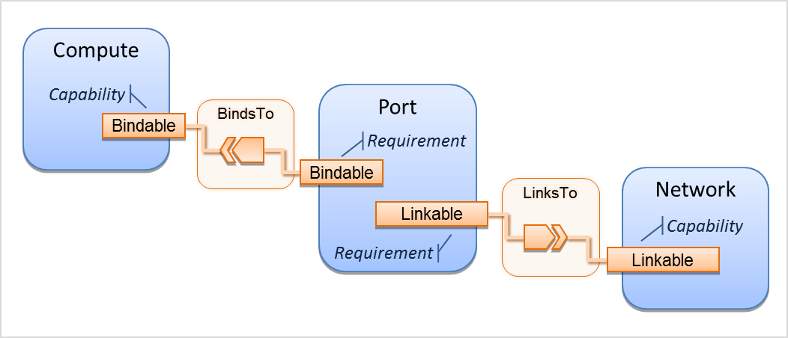
TOSCA Networking

Slide 22
Intro to NFV Modeling
ETSI Info Model for VNF Package and VNF Descriptor
TOSCA Data Model for VNF Descriptor

Slide 23


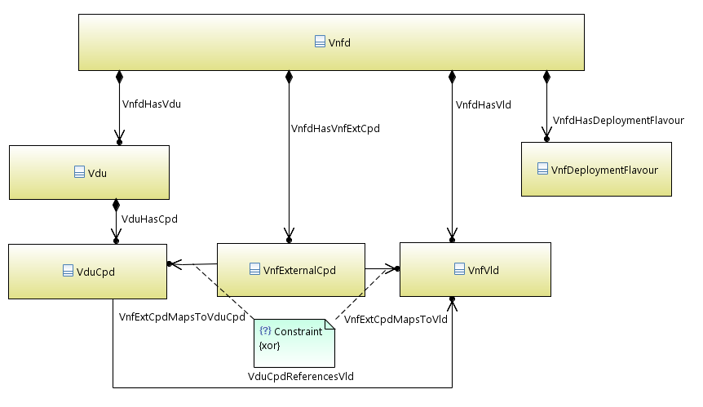
VNF Packaging & VNFD Info Model – ETSI NFV IFA011
Requirements for VNF Package
Use cases: On-boarding, Testing, Certification
Meta-data, integrity/authenticity, other
Info Model for VNFD – indorsed by ONAP
VDU (VNFC or VM) including Compute, Storage
Connection Points (VDU and External)
Virtual Link
Deployment Flavours
http://www.etsi.org/deliver/etsi_gs/NFV-IFA/001_099/011/02.01.01_60/gs_nfv-ifa011v020101p.pdf
Endorsed by ONAP https://wiki.onap.org/pages/viewpage.action?pageId=16004636

Slide 24







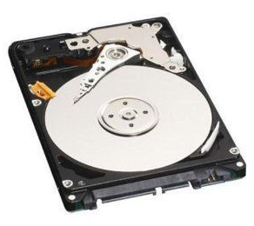



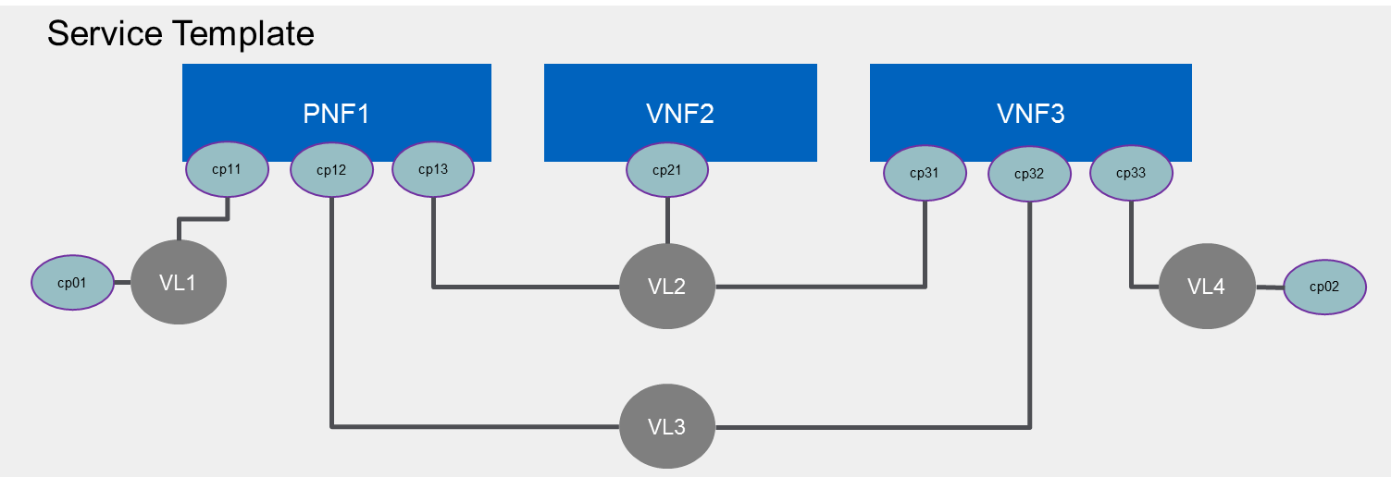
VNF Modeling, Packaging and On-boarding
VNF Package and VNFD Info Model ETSI NFV-IFA011
TOSCA CSAR based VNF package ETSI NFV-SOL004
TOSCA based VNFD data model ETSI NFV-SOL001 (draft)
ETSI NFV GS SOL004
VNF Package – TOSCA CSAR
├── Definitions
| └── VNFD.yaml
| └── VNFC.yaml
├── Artifacts/Scripts
| ├── install.sh
| └── start.yang
| └── vFW.img
└── TOSCA-Metadata
└── TOSCA.meta
└── Manifest (digests)
Service Provider Portal
Vendor
VNF X
SO/MSO
ETSI NFV GS SOL001
SDC
A&AI
DCAE
Distribution
Notes:
Create a best practice reusing OpenSource, SDOs, service providers experience
Facility to validate and certify the vendor deliverables based on the best practice

Slide 25

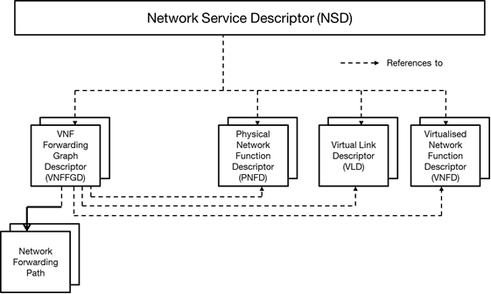
NS Descriptor Info Model – ETSI NFV IFA 014
Based on VNFD standard (IFA011)
Multi-Domain: DC, WAN, Access
Describes LCM for VNF’s and Provisioning for PNF’s, Deployment Flavor, Policy
http://www.etsi.org/deliver/etsi_gs/NFV-IFA/001_099/014/02.01.01_60/gs_nfv-ifa014v020101p.pdf

Slide 26
VNF Descriptor (VNFD)
The VNFD defines VNF properties, such as:
Resources needed (amount and type of Virtual Compute, Storage, Networking),
Software metadata,
Connectivity (descriptors for):
External Connection Points
Internal Virtual Links
Internal Connection Points
Lifecycle management behavior (e.g. scaling, instantiation),
Supported lifecycle management operations, and their configuration,
Supported VNF specific parameters, and
Affinity / anti-affinity rules.
The VNFD defines deployment flavours (size-bounded deployment configurations, e.g. related to capacity).
VNFD
VDU
Compute
Storage
Internal CPD
SW image Descr
Internal VLD
External CPD
Deployment Flavour
Reference:
ETSI GS NFV-IFA 011
ETSI GS NFV-SOL 001*
* Pre-publication stage – drafts available

Slide 27
VNF Descriptor (VNFD)
VNF Descriptor
Logical view
VNFD
VNF
VNFC1
VNFC2
VDU
Compute
Storage
Internal Cp
Sw Image
ICP1
ICP2
ICP3
ICP4
ECP1
IVL1
IVL2
ECP2
Internal VLD
level of resources to be instantiated within a deployment flavour in term of the number VNFC instances to be created for each VDU
Instantiation Level
External CPD
describes additional instantiation data for a given VDU.Compute used in the a specific deployment flavour.
VDU Profile
Deployment Flavour
VL Profile
additional instantiation data for a given VL used in a specific deployment flavour
VNF LCM Op Config
represents information to configure lifecycle management operations
Note: simplified view and contents, some information elements are not illustrated
Scaling Aspect
describes the details of an aspect used for horizontal scaling

Slide 28

Mapping IFA 011 elements with TOSCA types
IFA 011 Elements | VNFD TOSCA types | Derived from
VNFD | tosca.nodes.nfv.VNF | tosca.nodes.Root
Vdu | n/a | n/a
Cpd (Connection Point) | tosca.nodes.nfv.Cp | tosca.nodes.Root
VduCpd (internal connection point) | tosca.nodes.nfv.VduCp | tosca.nodes.nfv.Cp
VnfVirtualLinkDesc (Virtual Link) | tosca.nodes.nfv.VnfVirtualLink | tosca.nodes.Root
VnfExtCpd (External Connection Point) | tosca.nodes.nfv.VnfExtCp | tosca.nodes.nfv.Cp
Virtual Storage | tosca.nodes.nfv.Vdu.VirtualStorage | tosca.nodes.Root
Virtual Compute | tosca.nodes.nfv.Vdu.Compute | tosca.nodes.Root
Software Image | tosca.artifacts.nfv.SwImage | tosca.artifacts.Deployment.Image
Deployment Flavour | In progress | TBD
Scaling Aspect | In progress | TBD
Element Group | In progress | TBD
Instantiation Level | In progress | TBD
IFA 011 information model
SOL001 (v0.6.0): based on TOSCA Simple YAML Profile v1.2.
In the case of single deployment flavour, SOL001 support both TOSCA Simple YAML Profile vv1.1 and 1.2.
SOL001 (v0.6.0) is working draft, expecting a stable draft (VNFD part) by mid May 2018.
https://docbox.etsi.org/ISG/NFV/Open/Drafts/SOL001_TOSCA_desc/NFV-SOL001v060.zip
The content of this presentation is based on SOL011 v0.6.0

Slide 29
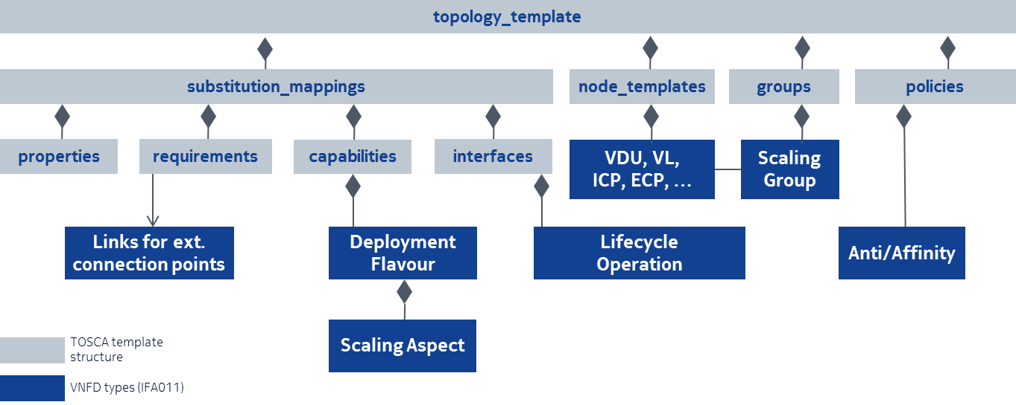
Mapping IFA 011 elements with TOSCA types

Slide 30
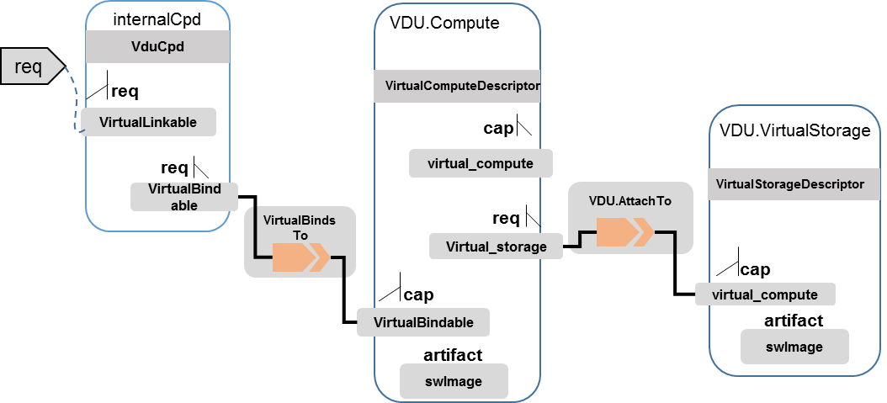
Basic Node Type – VDU.Compute

Slide 31
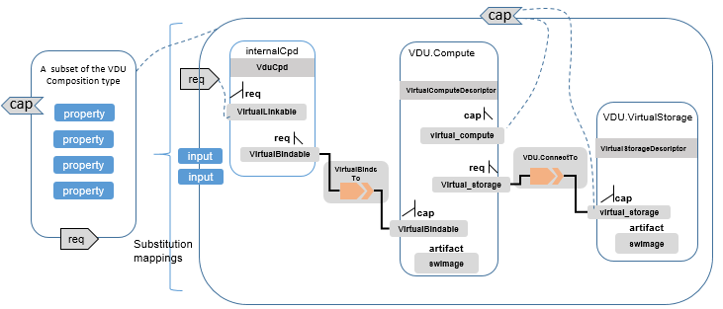
VDU Composition Design – Node Template Substitution
For a VNF descriptor design, VDU can be considered as the subsystem of a VNF descriptor
A standalone TOSCA service template can be used to define the topology of the VDU, and then the TOSCA composition can be used to abstract the VDU as a new node type

Slide 32
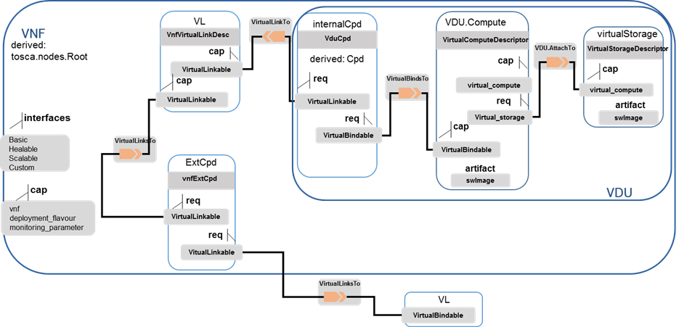
VNF Descriptor Design
VNF topology modeled in a cloud agnostic way using virtualized containers: VDU describe the capabilities of the virtualized containers, such as virtual CPU, RAM, disks; connectivity is modeled with VDU Connection Point Descriptors (VduCpd), Virtual Link Descriptors and VNF External Connection Point Descriptors;
VNF deployment aspects: they are described in one or more deployment flavours, including instantiation levels, supported LCM operations, VNF LCM operation configuration parameters, placement constraints (affinity / anti-affinity), min and max VDU instance numbers, and scaling aspect for horizontal scaling.

Slide 33
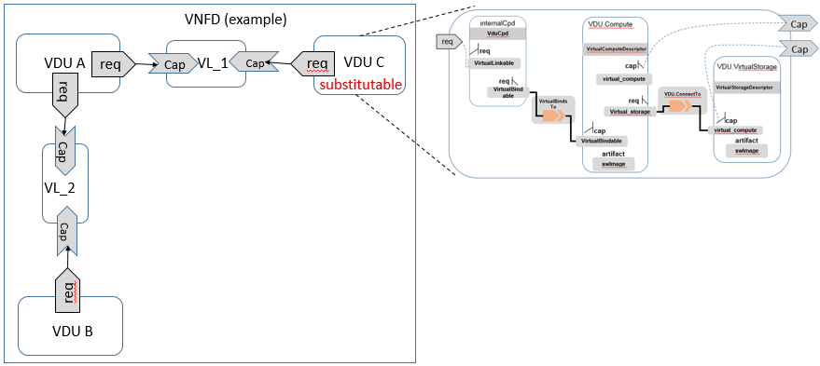
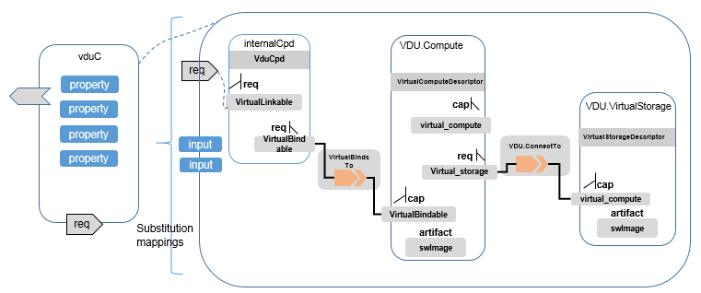
VNFD and VDU Design – Composition and Substitution
Composition
Substitution

Slide 34
VDU.Compute - tosca.nodes.nfv.VDU.Compute - Properties, requirements, capabilities, artifact
Name | Required | Type | Description
name | yes | string | Human readable name of the Vdu
description | yes | string | Human readable description of the Vdu
boot_order | no | list of string | The key indicates the boot index (lowest index defines highest boot priority). The Value references a descriptor from which a valid boot device is created e.g. VirtualStorageDescriptor from which a VirtualStorage instance is created. If no boot order is defined the default boot order defined in the VIM or NFVI shall be used.
nfvi_constraints | no | list of string | Describes constraints on the NFVI for the VNFC instance(s) created from this Vdu. For example, aspects of a secure hosting environment for the VNFC instance that involve additional entities or processes. More software images can be attached to the virtualization container using virtual_storage.
configurable_properties | yes | map of tosca.datatypes.nfv.VnfcConfigurableProperties | Describes the configurable properties of all VNFC instances based on this VDU.
Name | Required | Type | Description
virtual_storage | no | tosca.nodes.nfv.VDU.VirtualStorage | Describes storage requirements for a virtual_storage instance attached to the virtualization container created from virtual_compute defined for this vdu
Name | Type | Description
virtual_compute | tosca.capabilities.nfv.VirtualCompute | Describes virtual compute resources capabilities.
monitoring_parameter | tosca.capabilities.nfv.Metric | Monitoring parameter, which can be tracked for a VNFC based on this VDU Examples include: memory-consumption, CPU-utilisation, bandwidth-consumption, VNFC downtime, etc.
Virtual_binding | tosca.capabilities.nfv.VirtualBindable editor note: need to create a capability type | Defines ability of VirtualBindable
Name | Required | Type | Description
SwImage | Yes | tosca.artifacts.nfv.SwImage | Describes the software image which is directly loaded on the virtualization container realizing this virtual storage.

Slide 35
VDU VirtualStorage Node Type tosca.nodes.nfv.VDU.VirtualStorage – Properties, capabilities
tosca.nodes.nfv.VDU.VirtualStorage: derived_from: tosca.nodes.Root properties: #id: # node name type_of_storage: type: string required: true size_of_storage: type: scalar-unit.size required: true rdma_enabled: type: boolean required: false capabilities: virtual_storage: type: tosca.capabilities.nfv.VirtualStorage artifacts: - sw_image: file: type: tosca.artifacts.Deployment.Image
Name | Required | Type | Constraints | Description
id | yes |  |  | Unique identifier of the virtualStorage
type_of_storage | yes | string | volune, object | Type of virtualized storage resource
size_of_storage | yes | scalar-unit.size | number | Size of virtualized storage resource (in GB)
rdma_enabled | no | boolean |  | Indicate if the storage support RDMA
Name | Type | Description
virtual_storage | tosca.capabilities.nfv.VirtualStorage Editor Note: Need to create tosca.capabilities.nfv.VirtualStorage capability type. | Defines the capabilities of virtual storage.

Slide 36
VDU CPD Node Type tosca.nodes.nfv.VduCpd - Properties, Requirements
tosca.nodes.nfv.VduCpd: derived_from: tosca.nodes.nfv.Cpd properties: bitrate_requirement: type: integer required:false virtual_network_interface_requirements type: list entry_schema: type: VirtualNetworkInterfaceRequirements required:false requirements: - virtual_link: capability: tosca.capabilities.nfv.VirtualLinkable relationship: tosca.relationships.nfv.VirtualLinksTo node: tosca.nodes.nfv.VnfVirtualLinkDesc - virtual_binding: capability: tosca.capabilities.nfv.VirtualBindable relationship: tosca.relationships.nfv.VirtualBindsTo node: tosca.nodes.nfv.VDU
Name | Required | Type | Description
bitrate_requirement | no | integer | Bitrate requirement on this connection point.
virtual_network_interface_requirements | no | VirtualNetworkInterfaceRequirements [] | Specifies requirements on a virtual network interface realising the CPs instantiated from this CPD.
Name | Required | Type | Description
virtual_binding | yes | tosca.capabilities.nfv.VirtualBindable | Describe the requirement for binding with VDU
virtual_link | no | tosca.capabilities.nfv.VirtualLinkable | Describes the requirements for linking to virtual link

Slide 37
ETSI NFV-SOL 001: TOSCA service template overview
VNF
VnfVirtualLink
VduCp
Vdu.Compute
properties:
properties:
properties:
properties:
Vdu.VirtualStorage
Interfaces:
Nfv
VirtualLinkable
properties:
VirtualLinkable
virtual_compute
monitoring_parameter
VirtualBindable
virtual_storage
VirtualLinkable
VirtualLinkable
virtual_storage
VirtualBindable
VnfExtCp
artifacts:
swImage
Note 2
artifacts:
swImage
properties:
VDU
VNFD
VirtualLinkable
VirtualLinkable
Note 1: In the case of re-exposing a VduCp as external connection point (VnfExtCp).
Note 2: A node template of this type is used to represent a VNF external connection point only in the case the VnfExtCp is connected to an internal virtual link.
internal_virtual_link requirement to allow to connect it to an internal virtual link
external_virtual_link requirement to allow to connect it to an external virtual link
Symbol:
Note 1
VnfExtcp
(VduCp)
capabilities
properties:
requirements
VirtualLinkable
VirtualBindable
Namespace Prefix | Specification Description
toscanfv | The reserved TOSCA prefix that can be associated with the TOSCA Namespace URI as declared in the present document.

Slide 38
VNFD: Example
internalVl
tosca_definitions_version: tosca_simple_profile_yaml v 1.1
node_types:
MyCompany.SunshineDB.1_0.1_0:
derived_from: tosca.nodes.nfv.VNF
properties:
descriptor_id:
provider:
product_name:
software_version:
descriptor_version:
flavour_id:
...
interfaces:
Nfv:
topology_template:
substitution_mappings:
node_type: MyCompany.SunshineDB.1_0.1_0
requirements:
- virtual_link: [ dbBackendIpv4, external_virtual_link ] # IPv4 for SQL
node_templates:
dbBackend:
type: tosca.nodes.nfv.VDU.Compute
...
capabilities:
virtual_compute:
...
requirements:
- virtual_storage: mariaDbStorage
mariaDbStorage:
type: tosca.nodes.nfv.VDU.VirtualStorage
...
artifacts:
sw_image:
dbBackend
dbBackendInternalCp
dbBackendIpv4
VNF
externalVl
One deployment flavour
Vdu.Compute node: dbBackend
Two connection points: internal (dbBackendInternalCp); externa (dbBackendIp4)
Two virtual links: internalVl and externalVl
dbBackendInternalCp:
type: tosca.nodes.nfv.Cpd
...
requirements:
- virtual_binding: dbBackend
- virtual_link: internalVl
internalVl:
type: tosca.nodes.nfv.VL
...
dbBackendIpv4:
type: tosca.nodes.nfv.VduCpd
...
requirements:
- virtual_link:
- virtual_binding: dbBackend

Slide 39
SOL001: Compute, Storage, Connection Points Example
tosca_definitions_version: tosca_simple_profile_yaml v 1.1
node_types:
MyCompany.SunshineDB.1_0.1_0:
derived_from: tosca.nodes.nfv.VNF
...
topology_template:
...
node_templates:
dbBackend:
type: tosca.nodes.nfv.VDU.Compute
properties:
name: ..
description: ..
boot_order: ..
nfvi_constraints: ..
configurable_properties:
additional_vnfc_configurable_properties: {}
vdu_profile:
min_number_of_instances: 1
max_number_of_instances: 4
capabilities:
virtual_compute:
properties:
virtual_memory:
virtual_mem_size: 8096 MB
virtual_cpu:
cpu_architecture: x86
num_virtual_cpu: 2
virtual_cpu_clock: 1800 MHz
requirements:
- virtual_storage: mariaDbStorage
VduCp
Vdu.Compute
properties:
properties:
Vdu.VirtualStorage
virtual_compute
properties:
VirtualLinkable
virtual_storage
virtual_storage
VirtualBindable
VirtualBindable
artifacts:
swImage
mariaDbStorage:
type: tosca.nodes.nfv.VDU.VirtualStorage
properties:
type_of_storage: ..
size_of_storage: ..
rdma_enabled: ..
artifacts:
sw_image:
name: Software of Maria Db
version: 1.0
checksum: 9af30fce37a4c5c831e095745744d6d2
container_format: qcow2
disk_format: bare
min_disk: 2 GB
min_ram: 8096 MB
size: 2 GB
sw_image: maria.db.image.v1.0.qcow2
operating_system: Linux
supported_virtualisation_environments:
- KVM
dbBackendInternalCp:
type: tosca.nodes.nfv.Cpd
properties:
layer_protocol: ipv4
role: leaf
description: Internal connection point on an VL
requirements:
- virtual_binding: dbBackend
- virtual_link: internalVl

Slide 40
Internal Connectivity Example
tosca_definitions_version: tosca_simple_profile_yaml v 1.1
node_types:
MyCompany.SunshineDB.1_0.1_0:
derived_from: tosca.nodes.nfv.VNF
topology_template:
node_templates:
dbBackendInternalCp:
type: tosca.nodes.nfv.Cpd
properties:
layer_protocol: ipv4
role: leaf
description: Internal connection point on an VL
requirements:
- virtual_binding: dbBackend
- virtual_link: internalVl
internalVl:
type: tosca.nodes.nfv.VnfVirtualLink
properties:
connectivity_type:
layer_protocol: ipv4
flow_pattern: mesh
test_access: []
description: ..
vl_profile:
qos:
maxBitRateRequirements:
minBitRateRequirements:
internalVl
dbBackend
dbBackendInternalCp
dbBackendIpv4
VNF
externalVl
VnfVirtualLink
VduCp
properties:
properties:
VirtualLinkable
VirtualLinkable
VirtualLinkable
VirtualBindable

Slide 41
External Connectivity (Example: re-exposing a VduCp)
tosca_definitions_version: tosca_simple_profile_yaml v 1.1
node_types:
MyCompany.SunshineDB.1_0.1_0:
derived_from: tosca.nodes.nfv.VNF
topology_template:
node_templates:
dbBackendIpv4:
type: tosca.nodes.nfv.VduCpd
properties:
layer_protocol: ipv4
role: leaf
description: External connection point to access the DB on IPv4
requirements:
- virtual_link:
- virtual_binding: dbBackend
internalVl
dbBackend
dbBackendInternalCp
dbBackendIpv4
VNF
externalVl
Vdu.Compute
properties:
VnfExtcp
(VduCp)
virtual_compute
properties:
virtual_storage
VirtualLinkable
VirtualBindable
VirtualBindable
artifacts:
swImage

Slide 42
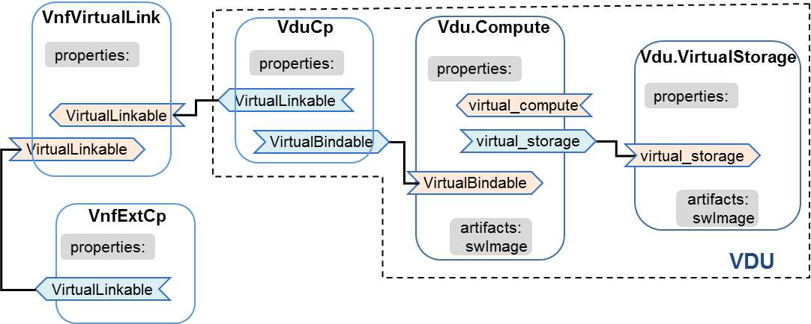
VNF LCM “event” and “scripts”
tosca_definitions_version: tosca_simple_profile_yaml v 1.1
node_types:
MyCompany.SunshineDB.1_0.1_0:
derived_from: tosca.nodes.nfv.VNF
properties:
interfaces:
Nfv:
instantiate:
inputs:
parameter_1:
type: string
required: false
default: value_1
parameter_2:
type: string
required: false
default: value_2
terminate:
implementation: terminate.workbook.mistral.yaml
topology_template:
substitution_mappings:
node_type: MyCompany.SunshineDB.1_0.1_0
requirements:
- virtual_link: [ dbBackendIpv4, external_virtual_link ] # IPv4 for SQL
VNF
properties:
Interfaces:
Nfv
monitoring_parameter
VirtualLinkable
VNFD
node_templates:
dbBackend:
type: tosca.nodes.nfv.VDU.Compute
mariaDbStorage:
type: tosca.nodes.nfv.VDU.VirtualStorage
dbBackendInternalCp:
type: tosca.nodes.nfv.Cpd
internalVl:
type: tosca.nodes.nfv.VnfVirtualLink
dbBackendIpv4:
type: tosca.nodes.nfv.VduCpd

Slide 43
VNF Deployment Flavour (Work in Progress) – Using Substitution Mapping
VNFD
Top level
Low level templates
VNF_DF1.yaml
VNFD service template (VNFD.yaml)
tosca_definitions_version: tosca_simple_yaml_1_2
substitution mapping
node_type: tosca.nodes.nfv.example_VNF
properties:
flavour_id: flavour1
node_templates:
VDU_1:
VDU_2:
tosca_definitions_version: tosca_simple_yaml_1_2
imports:
VNF_DF1.yaml
VNF_DF2.yaml
metadata:
Node types:
tosca.nodes.nfv.example_VNF:
derived_from: tosca.nodes.nfv.vnf
properties:
flavour_ID:
constraints:
- valid_values: [ flavour1, flavour2 ]
VNF_DF2.yaml
tosca_definitions_version: tosca_simple_yaml_1_2
substitution mapping
node_type: tosca.nodes.nfv.example_VNF
properties:
flavour_id: flavour2
node_templates:
VDU_1:
VDU_2:
VDU_3:
topology_template:
inputs:
deployment_flavor:
type: string
node_template:
VNF1:
type: tosca.nodes.nfv.example_VNF
VNFD_ID:
flavor_ID: { get_input: deployment_flavour}
# either flavour1 or flavour2

Slide 44
Using Group and Policy (Work in Progress)
Group Type logical grouping types for nodes for different management purposes.
Can be viewed as logical nodes that are not part of the physical deployment topology
Have capabilities to attach policies and interfaces that can be applied to its member nodes;
Associating elements of a VNFD (VDU’s and VnfVirtualLink’s) for affinity, scaling aspects etc.
node_template: VDU_2: Type: tosca.nodes.nfv.Vdu.Compute groups: localGroup_1: Type: tosca.groups.nfv.PlacementGroup Members: [VDU_2] policies policy_antiaffinity_local_VDU_2: type: tosca.policies.nfv.AntiAffinity targets: [localGroup_1 ] properties: scope: NFVI-node
Option 1: Policy built-in
within a group definition
Option 2: Policy type in conjunction
with group type
tosca.policies.nfv.AffinityRule: derived_from: tosca.policies.Placement properties: scope: type: string description: scope of the rule is an NFVI-node, an NFVI-PoP, etc. required:true constraints: - valid_values: [ NFVI-node, Zone, ZoneGroup, NFVI-PoP ] Targets:[tosca.nodes.nfv.Vdu.Compute, tosca.nodes.nfv.VnfVirtualLink, tosca.groups.nfv.ElementGroup]
tosca.groups.nfv.AffinityOrAntiAffinityGroup: derived_from: tosca.groups.Root properties: group_type: string type: string constraints: - valid_values: [Affinity, AntiAffinity ] scope: type: string constraints: - valid_values: [ NFVI-node, Zone, ZoneGroup, NFVI-PoP ] group_affinity: type: tosca.groups.nfv..AffinityOrAntiAffinityGroup properties: group_type: Affinity scope: NFVI-node members: [ VNFC_1, VNFC_2 ]
node_template: VDU_1: Type: tosca.nodes.nfv.Vdu.Compute VDU_2: Type: tosca.nodes.nfv.Vdu.Compute groups: affinityOrAntiAffinityGroup_1: Type: tosca.groups.nfv.PlacementGroup Members: [VDU_1, VDU_2] policies: policy_antiaffinity_group_1: type: tosca.policies.nfv.AntiAffinity targets: [affinityOrAntiAffinityGroup_1] properties: scope: NFVI-node
tosca.policies.nfv.AntiAffinityRule: derived_from: tosca.policies.Placement properties: scope: type: string description: scope of the rule is an NFVI-node, an NFVI-PoP, etc. required:true constraints: - valid_values: [ NFVI-node, Zone, ZoneGroup, NFVI-PoP ] Targets:[tosca.nodes.nfv.Vdu.Compute, tosca.nodes.nfv.VnfVirtualLink, tosca.groups.nfv.ElementGroup]

Slide 45
Other Capabilities and Main Data Types
ETSI NFV Element [ETSI NFV-IFA011] | TOSCA VNFD [TOSCA-Simple-Profile-NFV-v1.0] | Description
Monitoring | tosca.capabilities.nfv.Metric derived_from: tosca.capabilities.Endpoint | A node type that includes the Metric capability indicates that it can be monitored using an nfv.relationships.Monitor relationship type
Capabilities for Connectivity | tosca.capabilites.nfv.VirtualBindable derived_from: tosca.capabilities.Node | A node type that includes VirtualBindable capability indicates that it can be pointed by tosca.relationships.nfv.VirtualBindsTo (from CPD)
 | tosca.capabilities.nfv.VirtualLinkable derived_from: tosca.capabilities.Node | A node type that includes the VirtualLinkable capability indicates that it can be pointed by tosca.relationships.nfv.VirtualLinksTo relationship type (in CPD)
 | tosca.capabilities.nfv.ExtVirtualLinkable | A node type that includes the ExtVirtualLinkable capability indicates that it can be pointed by tosca.relationships.nfv.ExtVirtualLinksTo relationship type (External CPD)
VnfcConfigurableProperties | tosca.datatypes.nfv.VnfcConfigurableProperties | VnfcConfigurableProperties describes VirtualCpuPinning describes additional configurable properties of a VNFC
VirtualNetworkInterfaceRequirements | tosca.datatypes.nfv.VirtualNetworkInterfaceRequirements | Complex data type used to describe requirements on a virtual network interface realizing the CPs instantiated from this CPD such as particular data plane acceleration library, an API to be exposed by a NIC, etc.
ConnectivityType | tosca.datatypes.nfv.ConnectivityType | layer_protocol Identifies the protocol Virtual Link gives access to (Ethernet, mpls, odu2, ipv4, ipv6, pseudo_wire) flow_pattern Identifies the flow pattern of the connectivity (Line, Tree, Mesh)

Slide 46
TOSCA VNF-D Node Type tosca.nodes.nfv.VNF - Properties, requirements, capabilities (ETSI NFV-IFA011)
Name | Required | Type | Constraints | Description
descriptor_id | yes | string | GUID | Identifier of this VNFD information element. This attribute shall be globally unique. The format will be defined in the data model specification phase. The VNFD Identifier shall be used as the unique identifier of the VNF Package that contains this VNFD. Any modification of the content of the VNFD or the VNF Package shall result in a new VNFD Identifier.
descriptor_version | yes | string |  | Identifies the version of the VNFD.
provider | yes | string |  | Provider of the VNF and of the VNFD.
product_name | yes | string |  | Name to identify the VNF Product. Invariant for the VNF Product lifetime.
software_version | yes | string |  | Software version of the VNF. This is changed when there is any change to the software that is included in the VNF Package.
product_info_name | yes | string |  | Human readable name for the VNF Product. Can change during the VNF Product lifetime.
product_info_description | no | string |  | Human readable description of the VNF Product. Can change during the VNF Product lifetime.
vnfm_info | yes | list |  | Identifies VNFM(s) compatible with the VNF described in this version of the VNFD.
localization_languages | no | list |  | Information about localization languages of the VNF (includes e.g. strings in the VNFD). This allows to provide one or more localization languages to support selecting a specific localization language at VNF instantiation time.
default_localization_language | no | string |  | Default localization language that is instantiated if no information about selected localization language is available. Shall be present if "localizationLanguage" is present and shall be absent otherwise.
Name | Required | Type | Constraints | Description
virtual_link | yes | tosca.nodes.nfv.VL |  | Describes the requirements for linking to virtual link
Name | Type | Constraints | Description
vnf | tosca.capabilities.nfv.VNF |  | Describes the capabilities of VNF
deployment_flavour | tosca.capabilities.nfv.VnfDeploymentFlavour |  | Describes specific deployment flavour of a VNF with specific requirement for capacity and performance.
monitoring_parameter | tosca.capabilities.nfv.Metric | none | Monitoring parameter, which can be tracked for a VNF
NOTE: Modeled as ad hoc capabilities in VNF node template.

Slide 47
TOSCA ECP Node Type tosca.nodes.nfv.ECP - Properties, requirements
tosca.nodes.nfv.ECP: derived_from: tosca.nodes.nfv.Cpd properties: virtual_network_interface_requirements: type: list entry_schema: type: tosca.datatypes.nfv.VirtualNetworkInterfaceRequirements required: false requirements: - external_virtual_link: capability: tosca.capabilities.nfv.VirtualLinkable relationship: tosca.relationships.nfv.VirtualLinksTo node: tosca.nodes.nfv.VL - internal_virtual_link: #name in ETSI NFV IFA011 v0.7.3 intVirtualLinkDesc capability: tosca.capabilities.nfv.VirtualLinkable relationship: tosca.relationships.nfv.VirtualLinksTo node: tosca.nodes.nfv.VL occurrences: [ 0, 1 ] # 0 if re-exposing a VduCpd # 1 if connecting to an internal VL
Name | Required | Type | Description
virtual_network_interface_requirements | no | tosca.datatypes.nfv.VirtualNetworkInterfaceRequirements | The actual virtual NIC requirements that is been assigned when instantiating the connection point.
Name | Required | Type | Description
external_virtual_link | no | tosca.capabilities.nfv.VirtualLinkable | Describes the requirements for linking to virtual link
internal_virtual_link | no | tosca.capabilities.nfv.VirtualLinkable | Described the requirements for internal virtual link. This requirement is present when the VNF external connection point has a connection to an internal VL. This requirement is not present when the external connection is substituted by an Vdu connection point.

Slide 48
Virtual Link Node Type tosca.nodes.nfv.VnfVirtualLinkDesc - Properties, Capabilities
tosca.nodes.nfv.VnfVirtualLinkDesc: derived_from: tosca.nodes.Root properties: connectivity_type: type: tosca.datatypes.nfv.ConnectivityType required: true description: type: string required: false test_access: type: list entry_schema: type: string required: false vl_flavours: type: map entry_schema: type: tosca.datatypes.nfv.VlFlavour required: true capabilities: #monitoring_parameters: # modeled as ad hoc (named) capabilities in node template virtual_linkable: type: tosca.capabilities.nfv.VirtualLinkable
Name | Required | Type | Description
connectivity_type | yes | ConnectivityType | specifies the protocol exposed by the VL and the flow pattern supported by the VL
description | no | string | provides human-readable information on the purpose of the VL (e.g. control plane traffic)
test_access | no | string | Test access facilities available on the VL (e.g. none, passive, monitoring, or active (intrusive) loopbacks at endpoints
vl_flavours | yes | Map of tosca.datatypes.nfv.VlFlavour Editor’s note: TBD | Describe a specific flavour of the VL with specific bitrate requirements.
Name | Type | Description
virtual_linkable | tosca.capabilities.nfv.VirtualLinkable | Defines ability of VirtualLinkable
monitoring_parameter | tosca.capabilities.nfv.Metric Editor’s note: TBD | Monitoring parameter, which can be tracked for virtualized resource on VL level

Slide 49
SOL001 Status
VNFD specification ongoing in ETSI NFV SOL WG (SOL001)
Work in progress:
deploymentFlavour: instantiationLevel, ScaleInfo
elementGroup
vnfIndicator and monitoring
autoScale
Network Service Descriptor (NSD)
Stable Draft milestone for the VNFD part of SOL001 = 2018.05.17
Way forward: join forces in standardization (ETSI NFV & OASIS TOSCA) and open source (ONAP)
Work plan schedule | Stable Draft | Final Draft | WG App | TB App
SOL001 "TOSCA-based NFV descriptors spec" | 2018.07.01 | 2018.08.26 | 2018.08.31 | 2018.09.30

Slide 50
Backup

Slide 51
CPD Node Type tosca.nodes.nfv.Cpd Properties
tosca.nodes.nfv.Cpd: derived_from: tosca.nodes.Root properties: layer_protocol: type:string constraints: - valid_values: [ethernet, mpls, odu2, ipv4, ipv6, pseudo_wire ] required:true role: #Name in ETSI NFV IFA011 v0.7.3 cpRole type:string constraints: - valid_values: [ root, leaf ] required:flase description: type: string required: false address_data: type: list entry_schema: type: tosca.datatype.nfv.AddressData required:false
Name | Required | Type | Constraints | Description
layer_protocol | yes | string | Valid values: Ethernet, mpls, odu2, ipv4, ipv6, pseudo-wire | Identifies which protocol the connection point uses for connectivity purposes
role | no | string | valid values: [ root, leaf ] | Identifies the role of the port in the context of the traffic flow patterns in the VNF or parent NS. For example a VNF with a tree flow pattern within the VNF will have legal cpRoles of ROOT and LEAF
description | no | string |  | Provides human-readable information on the purpose of the connection point (e.g. connection point for control plane traffic).
address_data | no | AddressData [] |  | Provides information on the addresses to be assigned to the connection point(s) instantiated from this Connection Point Descriptor.

Slide 52


VNF Package Model Requirements
Prod. Name
Compute Req.
Vendor ID
VNF Package Model
Storage Req.
Version
Business
Networking Req.
Change Log
Technical - VNF Descriptor
Resource Metadata
License – terms and conditions
VNF flavors
Description, type, category from VNF-D
SW Image
Connection Graph
Scale
Mgmt. API – SOL005
Operational Lifecycle
Monitoring FM, PM, Usage
LCM scripts
Policy
Fault/PM scripts
Testing
Usage scripts
Scale Scripts
Package Integrity & Authenticity
Opt. Functional Ca[abilities
Policy Scripts
Artifacts Integrity & Authenticity
SOL001 endorsing TOSCA NFV Profile
Testing Scripts
SOL004
Sensitive Artifacts Encryption
Security Features

